Slide 1
IDS 462 Lecture 10
Momentum Investing

Slide 2
Efficient Markets
The definition of an efficient market is one where prices fully reflect available information
So, as soon as relevant information that would affect the price of a security is available, its affect on the price of the security is calculated and the price is adjusted
Under this theory an investor cannot get a better rate of return than the market as a whole (for a given level of risk)
Do you understand why?

Slide 3
Different Forms of Efficiency
Weak-form efficiency means that current prices reflect all information available from past prices
So, building a time-series model to use in an investment strategy would be pointless under this form of market efficiency
  Because enough other investors would be using time-series models and going long or short based on the predictions
  If the model indicated to go long, then all the time- series investors would buy
    This would drive up the price
    With the higher price, the returns gained at the end of the month would be no better than buy and hold

Slide 4
Different Forms of Efficiency
Semi-strong form means that all publicly available information is reflected in the price
  Includes information from past prices, and quarterly accounting filings, etc
Strong form means that ALL information is available
  Including ‘insider’ information
    Information only the company executives know

Slide 5
Hierarchy of Forms
If the market is strong efficient then it is also semi-strong and weak efficient
However if a market is weakly efficient then it is not necessarily semi-strong efficient
So if a market is only weakly efficient, what would be a good investment strategy?

Slide 6
Thought Experiment on Efficiency
It is not credible to think that the market is completely efficient at all times
If it were, what would happen?
  There would be no way to beat the market
  All investors would become passive and only invest in broad market indexes
  New methods for predicting prices and earning abnormal returns would be undiscovered (thus the market would be inefficient) until...
  A new investor found a way to exploit the inefficiency, thus driving the prediction of the price into the current price, resulting in the market returning to efficiency

Slide 7
Other Thoughts About Efficiency
Saying that you cannot beat the market implies that you cannot get a better return for the same amount of risk
  Risk is measured by the volatility of the distribution of returns
Some people believe that you can beat the market
The other camp (anchored at the University of Chicago) believes that any abnormal return is associated with a higher level of risk

Slide 8
Momentum Investing
Jegadeesh & Titman wrote the seminal article on momentum investing in March of 1993
They analyzed stock prices from January 1965 to December of 1989
They looked at the prices of stocks at a given month and the price for that same stock 6 months previous
The formed deciles (10% groupings) by returns from the past 6 months (Do you understand what this means?)
They generally found that stocks in the top decile had greater subsequent average returns vs. stocks in the bottom decile

Slide 9
Momentum Investing
So stocks that gained in the past tended to have momentum that propelled their earnings higher
They analyzed the volatility and were comfortable that their returns were not simply a function of greater risk
What does this say about weak form efficiency as of March 1993
According to weak form efficiency, what would we expect to be true AFTER March 1993
We will investigate this, but first we need to cover some additional concepts and requirements

Slide 10
Value Weighted vs. Equal Weighed Portfolios
At one point in our analysis we will take the arithmetic average of the returns in the top and bottom deciles
This assumes an equal weighted portfolio
A contrast between an equal weighted vs. a value weighted portfolio is shown next

Slide 11
Value Weighed Portfolio
Suppose we own one share of stock AAA and it has a price of $100
We also own one share of BBB and its price is $10
If AAA goes down by 10% and BBB goes up by 10%, then we are certainly NOT riding even
Do you understand why?
We have purchased one share of each, so the amount of our investment is proportional to the value of each stock—Value weighted

Slide 12
Equal Weighted
If instead we owned one share of AAA (worth $100) and TEN shares of BBB (10*$10=$100) then our weights in the securities would be equal
Now if AAA went down by 10% and BBB went up by 10% we would be even
So, under equal weighted portfolios we can average the return rates

Slide 13
Client Questions
The client asks you the following questions
  Can we use a momentum strategy to generate abnormally high returns– that is, beat the market– on a risk adjusted basis
    How does the average return compare to buy and hold
    How does the volatility compare to buy and hold
    What are the Sharpe’s ratios for the two investment strategies
      Should the Sharp’s ratio be used?
  What do your findings say about weak-efficiency of the market and semi-strong efficiency

Slide 14
Define: Sharpe’s Ratio
This is Rx-Rf/std(Rx), where
  Rx is the average return for your investment strategy
  Rf is the return from the risk-free rate (use 6% annually (so divide by 12 for monthly)
  Std(Rx) is the standard deviation of the returns from your investment strategy
We will calculate and discuss this

Slide 15
Let’s See What Happens
If the market is weak efficient, then there should be no opportunity to benefit from using momentum strategies after March 1993 because investors would ‘bake’ these trends into the prices of the securities
We will use a set of price data from WRDS to determine whether the inefficiency continued to exist in 1994 and after
Download and unzip q091901495_sas7bdat.zip

Slide 16
Execute Momentum
Let’s talk through the program singleprogramafterindex.sas
Also, how is the data organized vs. how do we need it organized
  And what can we do about it

Slide 17
Technical Material
We calculated the Sharpe’s ratio using the standard deviation
When is a standard deviation not an ideal number? What is it supposed to measure?
We will examine the distributions of the returns using the graphics available in SAS and SPSS

Slide 18
Technical Material
You used the univariate procedure in an early homework to examine the distributions of some simple sets of numbers
SAS has added some hi-resolution plots to the univariate procedures
What is a probability plot?
What is a Box & Whisker Plot?

Slide 19
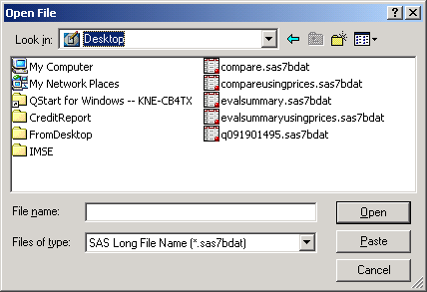
Technical Material
Open SPSS
Read in Compare on your desktop
You much change the file type to SAS Long File Name

Slide 20
Graphs In SPSS
After you read in the data go to
Analyze
  Descriptive Statistics
    Explore

Slide 21
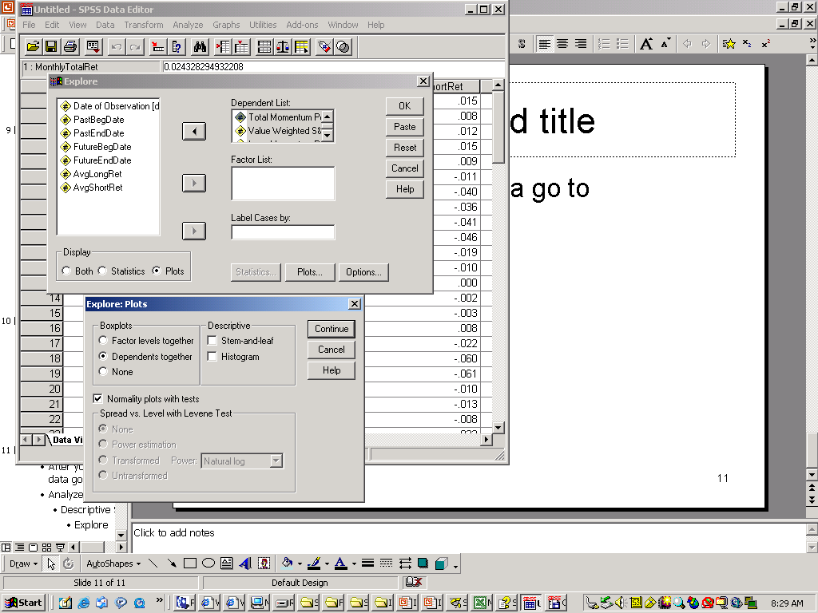
Making Graphs in SPSS
Move the four return variables into the dependent list
Display Plots (lower left)
Under the Plots.. Boxplots select Dependents together and Normal Probablity…
De-Select Stem-and-Leaf (upper right)

Slide 22
Quality Control For Memo
Business Memo
  Answer the client’s questions!!
  The last section should be titled Technical Note (or something similar)
    Make your client aware of the low outlier in the distribution of S&P500 returns so that….
    Show set of four boxplots made in SPSS to demonstrate the existence of the low outlier and comparison to outliers for other distributions
    Minimize technical jargon
    Explain terms that are not common business terms
Technical Appendix
  Very short
  Show four normal probability plots
  Discuss implications
    Mostly normal and largely free of outliers
    Except for S&P500

